Slide 1

Android Introduction
What is Android?
@2017 Zhijun Hong
1

Slide 2
What is Android?
Android 概述
  Android是一个开源的，基于Linux的移动设备操作系统，主要使用于移动设备，如智能手机和平板电脑。
  谷歌在2007年发布了第一个测试版本的 Android 软件开发工具包（SDK），第一个商业版本的 Android 1.0，则发布于2008年9月。
  Android 市场占有率
@2017 Zhijun Hong

Slide 3
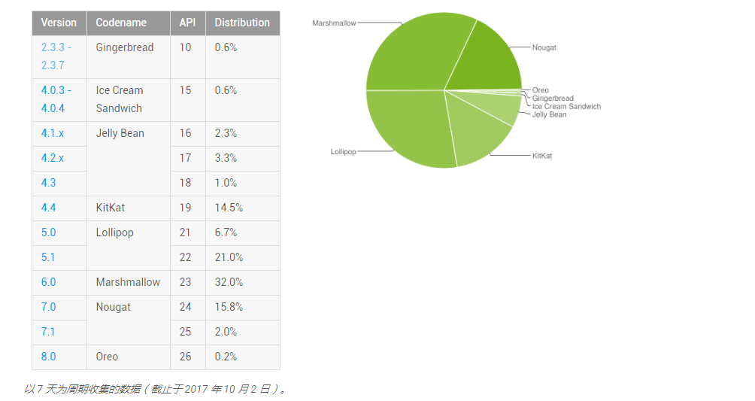
What is Android?
@2017 Zhijun Hong

Slide 4
What is Android?
  Android 版本演变
  棒棒糖 (Lollipop) 棉花糖(Marshmallow) 牛轧糖(Nougat) …
代号 | 版本 | API 级别
Nougat | 7.1 | API 级别 25
Nougat | 7.0 | API 级别 24
Marshmallow | 6.0 | API 级别 23
Lollipop | 5.1 | API 级别 22
Lollipop | 5.0 | API 级别 21
更多版本信息…
@2017 Zhijun Hong

Slide 5
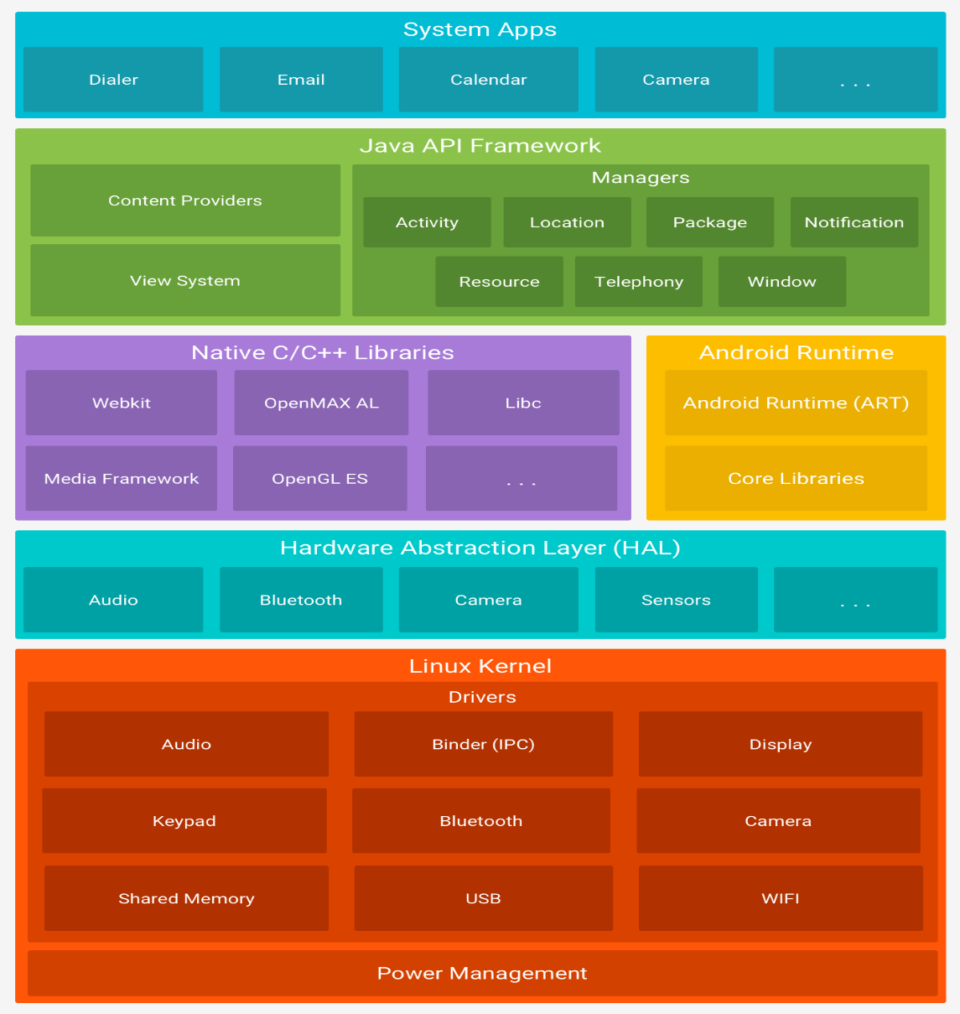
Android’s Architecture
平台架构
  Linux 内核
  硬件抽象层 (HAL)
  Android Runtime
  原生 C/C++ 库
  系统应用
@2017 Zhijun Hong

Slide 6
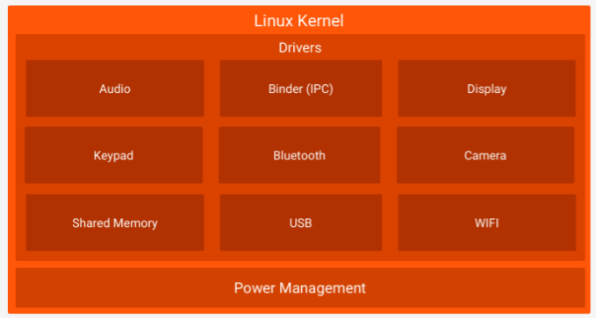
Android Architecture– LinuxKernel
Relying on Linux Kernel for co-re system services
  Memory and Process Management
  Network Stack
  Driver Model
  Security
@2017Zhijun Hong

Slide 7
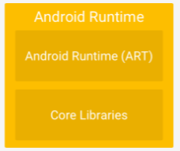
Android Architecture - Runtime
Core Libraries
  Providing most of the functionality available in the core libraries of the Java language
  APIs
    Data Structures
    Utilities
    File Access
    Network Access
    Graphics
    Etc
@2017 Zhijun Hong

Slide 8
Android Architecture– Runtime
Dalvik Virtual Machine
  Providing environment on which every Android application runs
    Each Android application runs in its own process, with its own instance of the Dalvik VM.
    Dalvik has been written such that a device can run multiple VMs efficiently.
  Register-based virtual machine
@2017Zhijun Hong

Slide 9
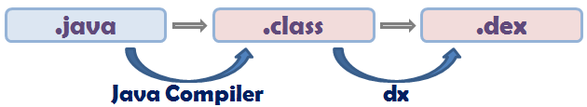
Android Architecture– Runtime
Dalvik Virtual Machine (Cont)
  Executing the Dalvik Executable (.dex) format
    .dex format is optimized for minimal memory footprint.
    Compilation
  Relying on the Linux Kernel for:
    Threading
    Low-level memory management
@2017 Zhijun Hong

